Slide 1
Artificial Intelligence (AI)
Topic 3: A Knowledge Based Agent: Robinson’s Inference Rule

Slide 2
Agenda
Robinson’s Inference Rule
Clausal Form of Knowledge Base According to Robinson’s Inference Rule
Natural Deduction
Types of Resolution
Learning Outcomes : KBS
Methodology and Assessment Criteria for the Subject

Slide 3
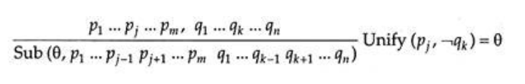
Robinson’s Inference Rule
This resolves literals p_{j} and q_{k}.
We have to add ¬ to q_{k} to make it unify with p_{j}, so it is in factor p_{j} which is the negative literal here
The rule is more general than first-order binary resolution in that it allows an arbitrary number of literals in each clause.
Ө is the most general unifier, rather than an arbitrary unifying substitution.

Slide 4
Robinson’s Inference Rule (Practice)
Take a pair of sentences α express
Then we find two literals, p_{j} and q_{k} for which we can find a substitution mu to unify p_{j} and ˥q
Take a disjunction of all the literals (in both the sentences) except p_{j} and q_{k}.
Finally, we apply the substitution Ө to the new disjunction to determine what we have just inferred using resolution.

Slide 5
Robinson’s Inference Rule (Example)
Let P = Loves (X, father-of (X))
Q₁ = Likes (X, mother-of (X)),
Q₂ = Likes (john, Y),
R = Hates (X, Y)
After Unifying Q₁ and Q₂
Q = Q₁ = Q₂ = (john, mother-of (john))
Where ‘the substitution S is given by
S = {john /X, mother-of (X) / Y}
= {john/X mother-of (john)/Y}
The resolvent (P v R) [s] is, thus, computed as follows.
(P v R)[S]
= Loves (john, father-of (john)) v hates (john, mother-of (john))

Slide 6
Robinson’s Inference Rule (Problem)
We imagine a room containing a monkey, a chair, and some bananas which have been hung from the center of the ceiling, out of reach from the monkey.
If the monkey is clever enough, he can reach the bananas by placing the chair directly below them and climbing on top of the chair.
The problem is to use FOL to represent this monkey- banana world and, using resolution, prove the monkey can reach the bananas

Slide 7
Robinson’s Inference Rule (Solution)
In creating a knowledge base, it is essential first to identify all relevant objects which will play some role in the anticipated inferences.
Irrelevant objects should be omitted, but never at the risk of incompleteness.
For example, in the current problem:
The monkey, bananas, and chair are essential.
Reference object needed such as the floor or ceiling to establish the height relationship between monkey and bananas.
Other objects : windows, walls or doors are not relevant.

Slide 8
Robinson’s Inference Rule (Solution)
In creating a knowledge base, it is essential first to identify all relevant objects which will play some role in the anticipated inferences.
Irrelevant objects should be omitted, but never at the risk of incompleteness.
For example, in the current problem:
The monkey, bananas, and chair are essential.
Reference object needed such as the floor or ceiling to establish the height relationship between monkey and bananas.
Other objects : windows, walls or doors are not relevant.

Slide 9
Robinson’s Inference Rule (Solution)
Establish important properties of objects, relations between them, and any assertions likely to be needed. These include following facts:
chair is tall enough to raise the monkey within reach of the bananas
the monkey is dexterous,
the chair can be moved under the bananas

Slide 10
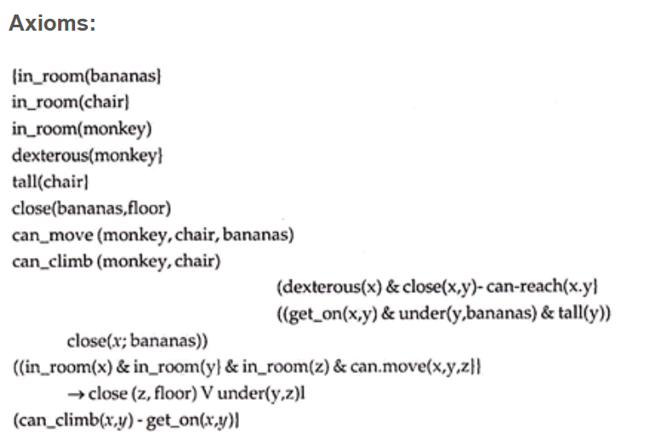
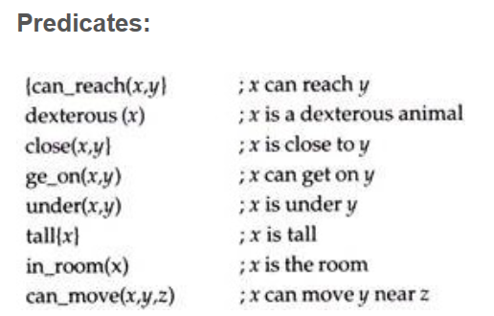
Creating Knowledge Base(KB) (1): Listing down
All variables are universally quantified.
Constants:
(floor, chair, bananas,
monkey)
Variables:
{x, y, z}

Slide 11

Robinson’s Rule Clausal Form of KB
Using the above axioms, a knowledge base can be written down directly in the required clausal from.
All that is needed to make the necessary substitutions are the equivalences
1. in_ room (monkey)
2. in_ room(bananas)
3. in_ room(chair)
4. tall (chair)
5. dexterous (monkey)
6. can_ move(monkey, chair, bananas)
7. can. climb (monkey, chair)
8. ‾close (bananas, floor)
9. ‾can_ climb(x, y) V get_ on(x, y)
10. ‾dexterous (x) V ‾close(x, y) V can_ reach(x, y)
11. ‾get_ on(x, y) V “under(y, bananas) V ‾tall(y) V close(x, bananas)

Slide 12
Robinson’s Rule Clausal Form of KB (2)
12. ‾in_ room(x) V– In_room(y) V _in_ room(z) V ‾can_ move(x, y, z) V close, floor) V under (y, z)
13.‾can_ reach(monkey, bananas)

Slide 13
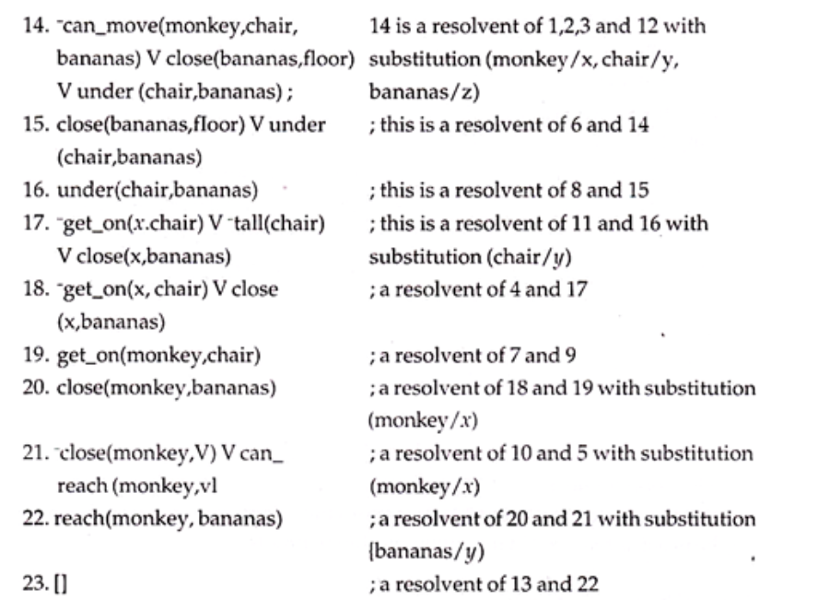
Resolution Proof
A proof that the monkey can reach the bananas is summarized here
this is a refutation proof where the statement to be proved (can_ reach(monkey, bananas)) has been negated and added to the knowledge base (number 13).

Slide 14
Natural Deduction By Robinson’s Rule (1)
The first difficulty is that for resolution theorem to be applicable sentences in first order logic need to be converted in to clause form.
Sometimes the heuristic information contained in the sentence remain logically true
Difficulty with resolution as theorem prover is that people do not think in terms of resolution
In the method of resolution there is no scope for the theorem prove either to give advice or to be advised. Interaction should be there between the theorem prover and Computer System. Computer Should behave like theorem prover similar to human theorem proving
All judges who are not crooked are well educated, expressed in predicate logic:
ᗄx Judge(x) ∧ ¬ Crooked(x) → Educated(x)
and after conversion into CNF.
¬ Judge(x) v Crooked (x) v Educated (x)
This form appears to deduce that some one is not a judge by showing that he is not crooked and not educated. And this is not a good method of defining a judge.

Slide 15
Natural Deduction By Robinson’s Rule (2)
Natural deduction should look more natural in not requiring just conversion of the sentences in to clausal form and the inference rules should appear natural to humans.
That is the first order predicate need not to have just conversion of sentence into CNF. In a way the inference rules should appear to computer as natural as to human being

Slide 16

Types of Resolution (1)
Binary Resolution
Binary resolution resolves exactly two literals in P v Q ∼ Q v R and we get ∼ PVR, written as:
Binary resolution gets its name from the fact that each sentence is a disjunction of exactly two literals
Two clauses having complementary literals are combined as disjuncts to produce a single clause after deleting the complementary literal
-P(x, a) V Q(x) and ‾Q(b)V R(x)
is just
-P(x, a) V R(b).
The substitution {b/x} was made in the two parent clauses to produce the complementary literals Q(b) and ‾Q(b) which were then deleted from the disjunction of the two parent clauses.
.
Unit Resolution
Resolution where one of the sentences is a single literal (called unit clause).
For resolving a unit clause P with any other sentence (clause) such as:
∼ P v ∼ Q v R
yields ∼ Q v R

Slide 17
Types of Resolution (2)
Subsumption:
This method of resolution works on the principle of Subsumption when specific clauses can be inferred from general one, throw away the specific clauses
This reduces the search space but still contains false.
E.g. P(x) is already in the knowledge base then there is no sense in adding P(a) and even less sensible in adding P(a) ∨ Q(b). Thus, given the clause C = P(x) ∨ Q(x, y)∨ P(f(z)) and the factor C’ = Cβ, P(f(z)) ∨ Q(f(z),y) ∨ P(f(z)) is obtained, with β = {f(z)/x}. However, the reduction of the search space is out weighed by the expense.
Unit Resulting Resolution (CUR):
A number of clauses are resolved simultaneously to produce a unit clause
All except one of the clauses are unit clauses, and that one clause has exactly one more literal than the total number of unit clauses.
E.g. { ‾MARRIED(x, y) V ‾MOTHER (x, z) V FATHER(y, z), MARRIED (sue, joe), ‾FATHER (joe, bill)}
Substitution a = {sue/x, joe/y, bill/z) is used, results in the unit clause ‾MOTHER (sue, bill).

Slide 18
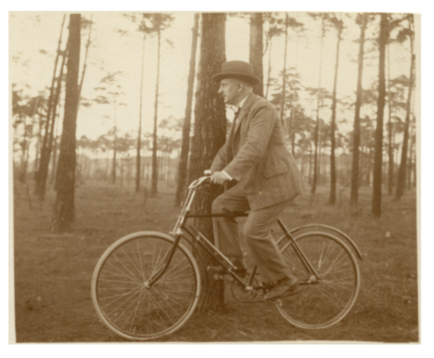
Scene Interpretation using Predicate Logic
Lets use B for the property of being a bicycle,
M for the property of being a man, and
R for the relation of riding,
Following formula describes the following salient fact about the situation in the picture:
∃x∃y : (M(x)∧B(y)∧R(x , y)

Slide 19
Methodology And Assessment Criterias
Class Assignment(s)
Each chapter being covered will have one assignment. The Case Studies will be given in line to the Changing with Speed across IT Projects in Kirirom
Internal Exam(s)
There will be 2 exams
Model Exam
There will be one Model Exam.
Semester Exam
There will be 1 Semester Exam

Slide 20
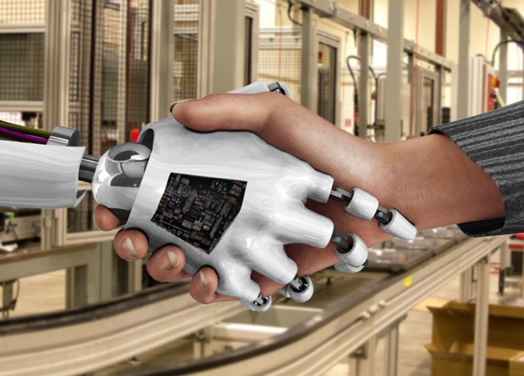
Thank You !
“An Algorithm Must Be Seen to Be Believed”
- Donald Knuth

